Slide 1
Advance Computer Architecture
RISC

Slide 2
Motivation
The motivation for the design of RISC processors arose from technological developments which changed gradually the architectural parameters traditionally used in the computer industry.
The philosophy of the time was to build machines which could diminish the semantic gap between high level languages and the machine language.

Slide 3
Motivation
Many special instructions were included in the instruction set in order to improve the performance of some operations and several machine instructions looked almost like their high-level counterparts.
Memory was slow and expensive - therefore compact code was required. There was a need for instructions of high encoded semantic content which could maintain the processor running at full speed with a minimum of instruction fetches.

Slide 4
Motivation
Microcode had also an additional advantage: it could be changed in different models of the same computer family, allowing for increased parallel execution of individual instructions in the high end of the family.
The project which is now recognized as the first pioneering RISC architecture was started 1975 at the IBM Research Center in Yorktown Heights, N.Y.

Slide 5
Motivation
A small computer system, which was intended originally to control a telephone exchange system, evolved into a minicomputer design which challenged the traditional computer architecture
Two projects which started some years later brought RISC concepts finally into the mainstream of computer architecture.

Slide 6
Motivation
The first one was led by David Patterson at the University of Berkeley and culminated in the definition of the RISC-I and RISC-II processors at the beginning of the eighties.
RISC systems access memory only with explicit load and store instructions.

Slide 7
Motivation
The underlying philosophy of RISC machines is that a system is better able to manage program execution when the program consists of only a few different instructions that are the same length and require the same number of clock cycles to decode and execute.
In CISC systems, many different kinds of instructions access memory, making instruction length variable and fetch-decode-execute time unpredictable.

Slide 8
OBJECTIVES
The instruction set must be kept simple
Instructions must run at the fastest possible rate
Pipelining is more important than program size
Large Register Set
Simple Addressing Modes
Fixed length coding and hardware decoding

Slide 9
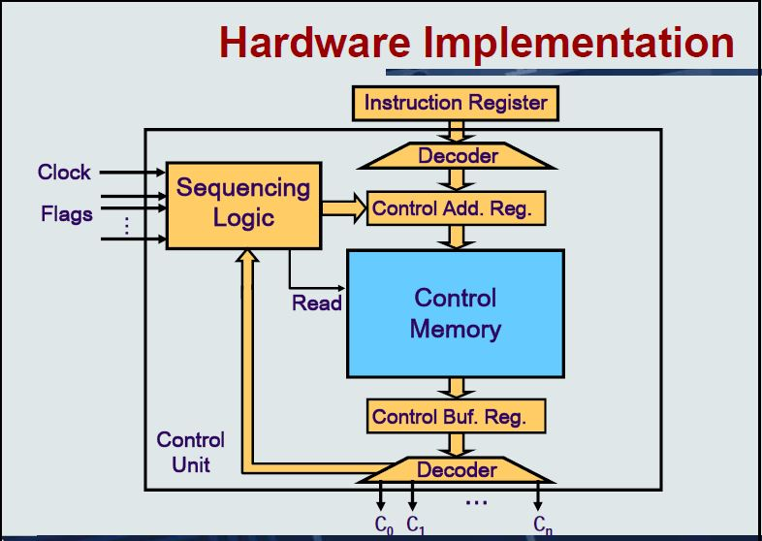
Architecture

Slide 10
Example
Consider the the program fragments:
Nnnnnnnn
The total clock cycles for the CISC version might be:
(2 movs × 1 cycle) + (1 mul × 30 cycles) = 32 cycles
While the clock cycles for the RISC version is:
(3 movs × 1 cycle) + (5 adds × 1 cycle) + (5 loops × 1 cycle) = 13 cycles
With RISC clock cycle being shorter, RISC gives us much faster execution speeds.
mov ax, 0
mov bx, 10
mul cx, 5
Begin add ax, bx
loop Begin
mov ax, 10
mov bx, 5
mul bx, ax
CISC
RISC

Slide 11





RISC Pipeline Stages
Fetch instruction
Decode instruction
Execute instruction
Access operand
Write result

Slide 12
Without Pipelining
Clock Cycle 1 2 3 4 5 6 7 8 9 10
Instr 1
Instr 2

Slide 13
With Pipelining
The processor is able to perform each stage simultaneously.
If the processor is decoding an instruction, it may also fetch another instruction at the same time.

Slide 14
With Pipelining
Clock Cycle 1 2 3 4 5 6 7 8 9
Instr 1
Instr 2
Instr 3
Instr 4
Instr 5

Slide 15
Simple Instructions
The designers of CISC architectures anticipated extensive use of complex instructions because they close the semantic gap.
In reality, it turns out that compilers mostly ignore these instructions. Several empirical studies have shown that this is the case.
The semantics of the C for loop is not exactly the same as that in other languages. Thus, compilers tend to synthesize the code using simpler instructions.

Slide 16
Few Data Types
CISC ISA tends to support a variety of data structures, from simple data types such as integers and characters to complex data structures such as records and structures.
Empirical data suggest that complex data structures are used relatively infrequently.

Slide 17
Simple Addressing Modes
CISC designs provide a large number of addressing modes. The main motivations are to support complex data structures and to provide flexibility to access operands.
Although this allows flexibility, it also introduces problems.
First, it causes variable instruction execution times, depending on the location of the operands. Second, it leads to variable-length instructions.
Variable instruction lengths lead to inefficient instruction decoding and scheduling.

Slide 18
Large Register Set
As a percentage of the total machine language instructions, call/return instructions are about 31 to 33%. More interesting is the fact that call/return generates nearly half (about 45%) of all memory references
This is understandable as procedure call/return instructions use memory to store activation records.
This explains why procedure call/return activities account for a large number of memory references.
Thus, it is worth providing efficient support for procedure calls and returns.

Slide 19
Simple Operations
The objective is to design simple instructions so that each can execute in one cycle. This property simplifies processor design.
The advantage of simple instructions is that there is no need for microcode and operations can be hardwired.

Slide 20
Register-to-Register Operations
A typical CISC instruction set supports register-to-register operations as well as register to- memory and memory-to-memory operations.
RISC processors allow only special load and store operations to access memory.
The rest of the operations work on a register-to-register basis. This feature simplifies instruction set design as it allows execution of instructions at a one-instruction-per-cycle rate. Restricting operands to registers also simplifies the control unit.

Slide 21
Conclusion
Less transistors and large register set needed in RISC
RISC processors have shorter design cycles
RISC instructions take less clock cycles than CISC instructions
CISC instructions take up to 3 to 12 times longer
Smaller instructions allowed for constants to be stored in the unused bits of the instruction
This would mean less memory calls to registers or main memory

Slide 22
Conclusion
A large instruction set requires complex and potentially time consuming hardware steps to decode and execute the instructions.
Complex machine instructions may not match high-level language statements exactly, in which case they may be of little use.
Instruction sets designed with specialized instructions for several high-level languages will not be efficient when executing program of a given language.
CISC is having complex design tasks.

Slide 23
Conclusion
TAKE A RISK……… OHHH SORRY!!! RISC IN LIFE… ☺

